Slide 1

IT Tickets Analysis

Slide 2
Problem Statement
The analysis focuses on analyzing IT support ticket management systems to understand agent performance, ticket resolution, and satisfaction levels, assessing team effectiveness, and making informed staffing decisions to improve service quality.

Slide 3

Did you know that Companies that invest in efficient IT ticketing systems see a 25% reduction in downtime and faster problem resolution.

Slide 4
Data overview
Total Tickets: 97,494
Total Agents: 50
Issue Types: IT Error, IT Request
Ticket Request Categories: Login Access, System, Hardware, Software
Priority: 0-Unassigned, 1-Low, 2-Mid, 3-High
Severity: 0-Unclassified, 1-Minor, 2-Normal, 3-Mayor, 4-Urgent

Slide 5
Objectives
Assess
Ticket Performance: Investigate resolution times, satisfaction rates, and agent productivity.
Improve
Operational Efficiency : Identify the impact of ticket resolution on overall business performance.
Guide
Strategic Investments: Recommend where to allocate resources—additional staff, training, or system upgrades.

Slide 6

Data Cleaning and Preprocessing​
Standardized ticket categories to ensure uniform classification.
Addressed missing resolution times using historical averages.
Removed duplicate tickets and filtered incomplete agent records.
The dataset offers insights into agent efficiency and IT issue trends.
Used functions like VLOOKUP, MAX,MIN,AVERAGE,AVERAGEIF etc...

Slide 7

Comprehensive Approach
Used LEFT, RIGHT, MID functions to extract and standardize information from the Ticket ID and Agent ID fields for uniformity across the dataset.
Replaced missing satisfaction rates with averages using the IFERROR function to ensure all records were complete.
Implemented PivotTables to compare agent performance based on ticket severity (urgent, major, minor) and resolution times.
Applied COUNTIFS to categorize tickets by issue type (IT Error, IT Agent), helping to identify common problems and inefficiencies in ticket handling.

Slide 8
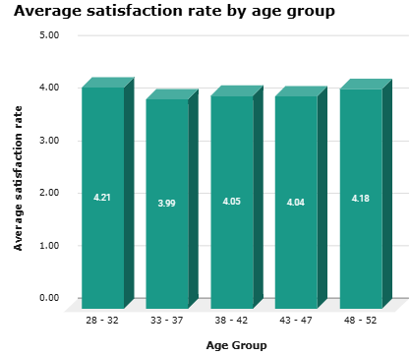
Average satisfaction rate by age group
The chart shows a consistently high level of satisfaction across all age groups, ranging from 3.99 to 4.21.
The highest average satisfaction rate is observed in the 28-32 age group at 4.21.
There is a slight dip in the satisfaction rate in the middle age groups (33-37 and 38-42).
The satisfaction rate increases again in the older age groups (43-47 and 48-52).

Slide 9
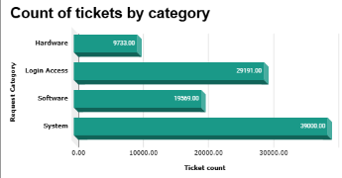
Count of tickets by category
System issues are the most frequent source of tickets with huge portion of 39000 tickets.
Users frequently encounter difficulties accessing accounts or systems results in 29191 tickets for login access issues.
Software-related problems are a significant source of support requests with 19569 tickets.
Hardware issues appear to be the least frequent category, with around 9,733 tickets.

Slide 10
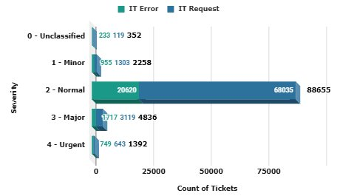
Count of Tickets by Severity
The number of IT Requests are significantly higher than the number of IT Errors.
The "Normal" severity level has the highest number of tickets for both IT Errors and IT Requests.
The number of "Urgent" tickets is comparatively low for both IT Errors and IT Requests.
The " Minor" severity level also sees a significant number of tickets, indicating that minor issues are frequently reported.

Slide 11
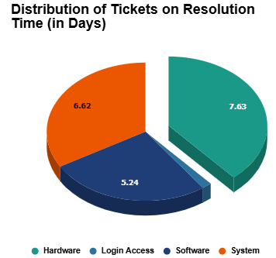
Distribution of Tickets by resolution time
(in days) by category
Hardware-related tickets take the longest time to resolve, with an average of 7.63 days, accounting for 38.5% of the total distribution.
System-related tickets account for 33.4% of the total distribution, with an average resolution time of 6.62 days.
Software-related issues account for 26.5% of the total distribution, with an average resolution time of 5.24 days.
Login Access represents the smallest portion of tickets at 1.8% and has a much shorter average resolution time.

Slide 12
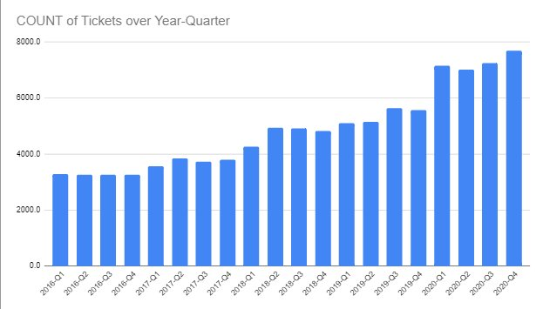
Ticket Volume Over Time
The growth appears gradual from 2016 to around 2019 and accelerates after 2020-Q1.
The rate of increase is much sharper starting from 2020. This could be due to specific events or changes in organizational demand.
The highest ticket counts occur in 2020-Q3 and 2020-Q4, with both quarters showing a sharp rise compared to previous periods.
The period from 2017-Q1 to 2019-Q4 shows steady but slower growth compared to the spike that happens in 2020.

Slide 13
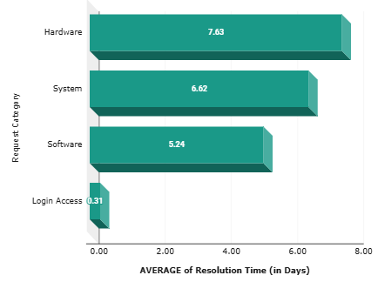
Average resolution time for each category
Login Access issues have the shortest average resolution time at 0.31 days.
Software issues have an average resolution time of 5.24 days.
System issues have an average resolution time of 6.62 days, suggesting that they take even longer to resolve than software issues.
Hardware issues have the longest average resolution time at 7.63 days implies that hardware problems are the most time-consuming to fix.

Slide 14
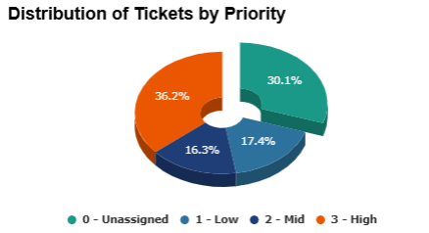
Distribution of Tickets by Priority
A large portion of tickets are currently unassigned, accounting for 36.2% of the total.
Low-priority tickets constitute the second-largest segment at 30.1%.
High-priority tickets make up only 17.4% of the total, suggesting that most issues are not considered critical or urgent.
Mid-priority tickets represent the smallest segment at 16.3%, indicating that a relatively small portion of issues require immediate attention.

Slide 15
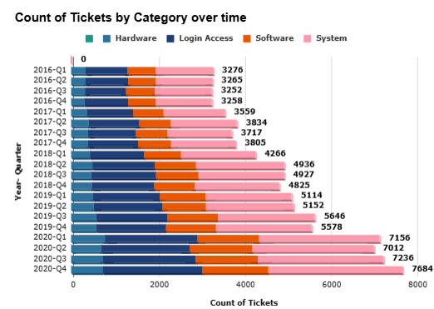
Count of Tickets by Category over time
System tickets have consistently been the most frequent type of ticket over the entire period shown.
There is a significant upward trend in the number of software tickets.
Hardware tickets have remained relatively stable over time.
Login access tickets seem to have a slight upward trend, but they remain a relatively small portion of the overall tickets.

Slide 16

Key Recommendations
Conduct a detailed analysis of current agent workloads to determine whether if additional staff are required to handle the ticket volume more efficiently.
Consider targeted training or hiring specialized personnel to address these deficiencies.
Factor in the time and resources necessary for effectively training and onboarding new hires.
Investigate whether delays in ticket resolution are caused by limitations in IT infrastructure.

Slide 17
Key Visualizations and Features
Totally 97,494 tickets were processed.
System tickets are the most frequent, followed by Software, Login Access, and Hardware.
Low priority tickets dominate, with high priority tickets being the least common.
Hardware tickets take the longest to resolve, while Login Access tickets have the quickest resolution time.
The majority of tickets are classified as "Normal" severity, followed by "Urgent" and "Major"
Satisfaction rates are relatively consistent across all age groups.

Slide 18

Conclusion
Most tickets fall under the Software and Hardware categories, with a high percentage of tickets being unassigned or low priority.
Agents across different age groups show varied performance, with the 28-32 age group resolving the most tickets.
Satisfaction rates remain stable, but mid-week shows slightly faster resolution times. This suggests opportunities for optimizing agent shifts and response times during peak days.
Customer satisfaction rates have consistently improved over the years, signaling progress but also areas for continuous development.

Slide 19

References
Data Source: IT Ticket System, IT Ticket Tracking Database
External Assistance: A System for ticket analysis and resolution by IBM
ITIL Framework: ITIL Foundation
Data Analysis Tools: Excel, Google Sheets
Statistical Methods: Descriptive statistics, regression analysis
Case Studies: "Improving IT Support Efficiency," Journal of IT Management, 2023

Slide 20
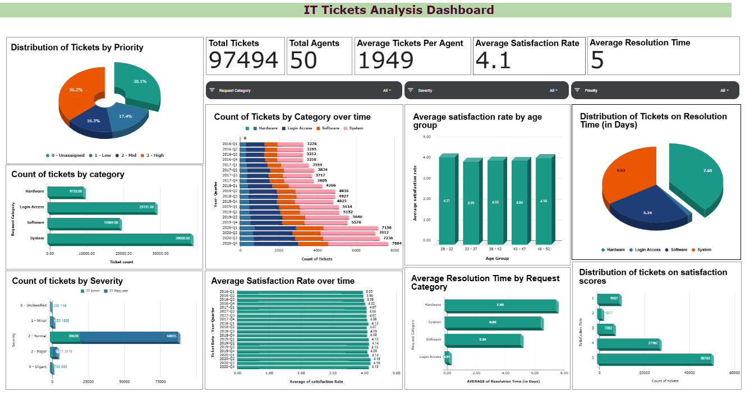
Dashboard Overview

Slide 21
Thank You

